Slide 1
How The InternET WORKS
A Lesson About A Simple Subject That Totally Fits Into An Hour and a Half.
Notes:
The subtitle is delivered as a joke since obviously you can’t fully explain how the internet works in 90 minutes

Slide 2
From Web To Web 2.0 AND BEYOND
Notes:
Start this portion after the research exercise

Slide 3
IN THE BEGINNING…
The Internet Begins As The ARPANET
TCP/IP becomes protocol
Services— FTP/Telnet/Gopher
But no web!
Notes:
Mention beginning in Defense Department, fact that many services existed but no universal easy to use platform. Briefly explain hypertext when introducing the web.

Slide 4


WEB 1.0
Give me a page!
Server
Client
Here’s a page!
Static web page: is delivered to the user exactly as stored.

Slide 5
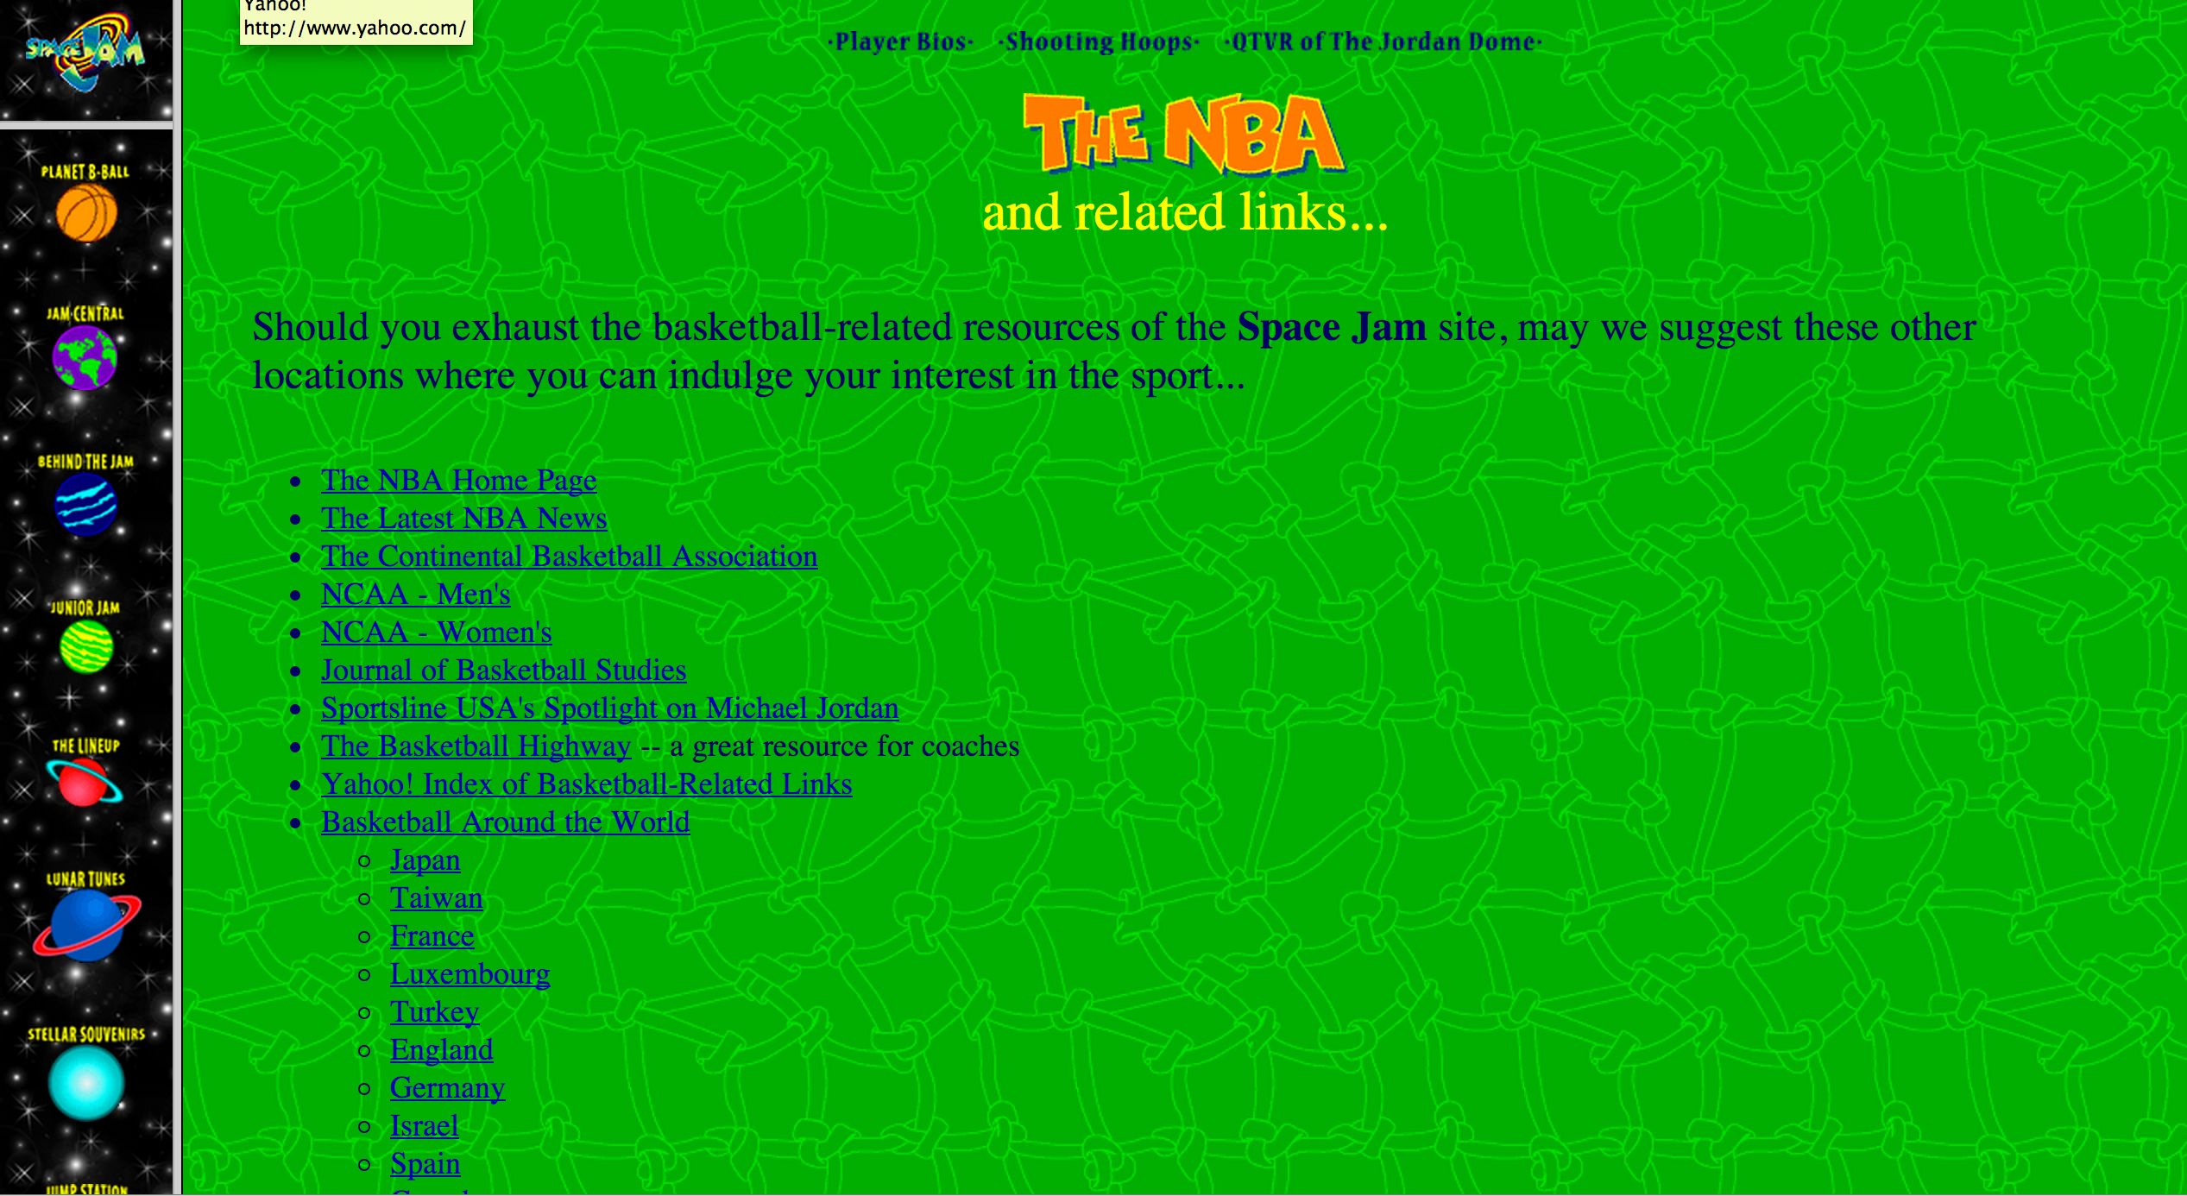
SPACE JAM WEBITE
It’s still up!

Slide 6
Web 2.0
Server Process Input
Gives Input
Updates Data
Sends back a computed
page
Sees Results
Notes:
Mention that “Web 2.0” is something of a buzzword, but that generally it refers to the moment when we transitioned from static pages to dynamic server based web application

Slide 7
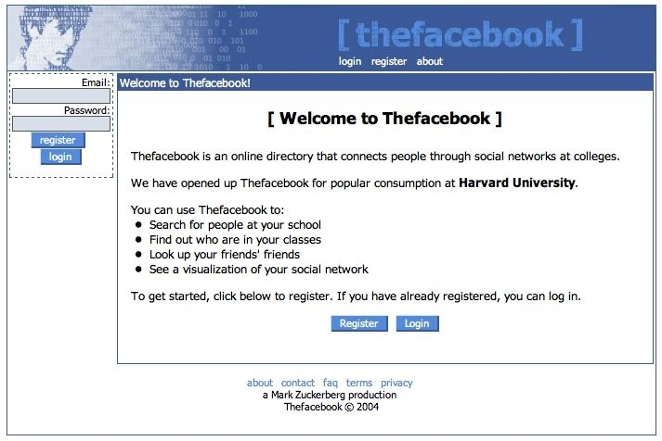
THE FACEBOOK
Go See the Social Network For More Info

Slide 8


Web 3.0?
JSON
JSON
Web Browser
(Angular/Ember)
Server Persists Data
And Some Logic
(Like Authentication)
Google Glass
App
JSON
iPhone App
Notes:
Make sure to mention that “Web 3.0” is not an accepted term, but that we’re referring to a third generation of web apps that work with a stripped down data/API server and are viewed on a variety of platforms

Slide 9
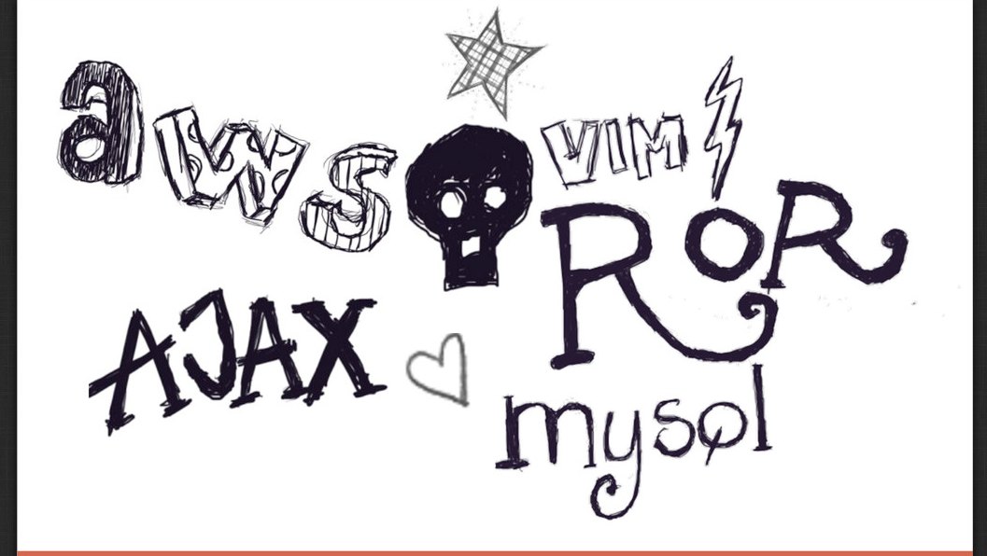
Do YOU SPEAK GEEK?
Notes:
This slide is cribbed from the Rails Girls Bento Box exercise. The explanation here is to say “lots of terms are thrown around, we want to help you speak geek by understand which roles a tool or technology plays in a web application”

Slide 10
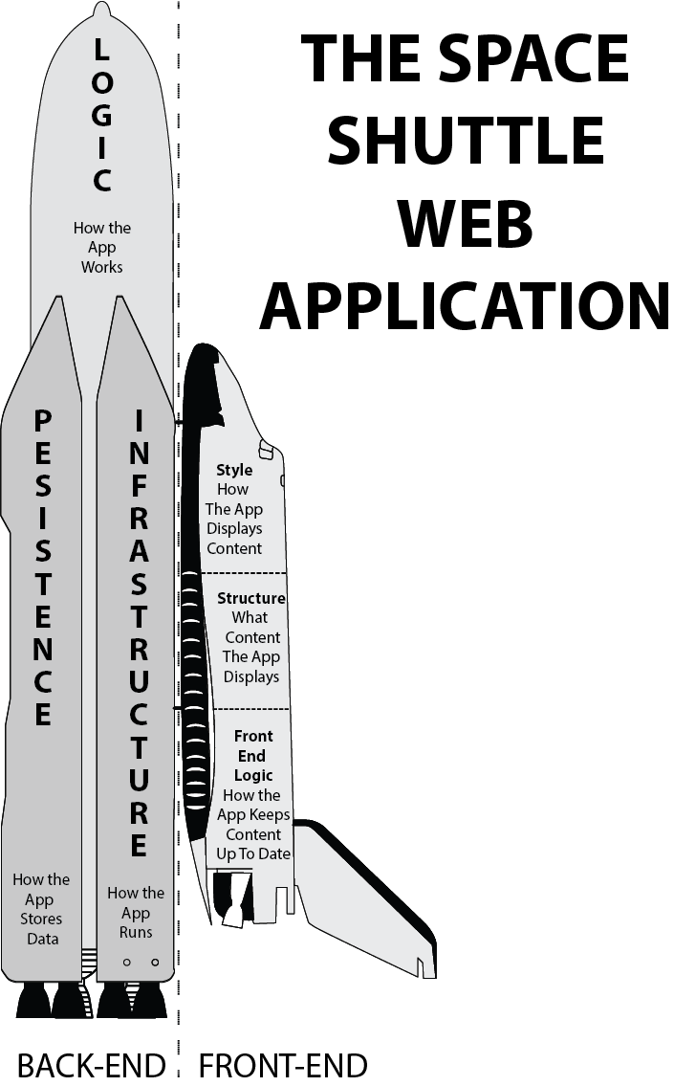
Web Stack
Python
HTML
Javascript
MySQL
MongoDB
Ruby on Rails
DOM
CSS
PHP
Angular.js
Ember.js
Apache
AWS
Notes:
This is a slide you spend a lot of time on.
Make sure to explain:
The key components of a web app— On the backend Persistence, Infrastructure, and Logic– on the Front end– Front End Logic, Style, and Structure
Following that, print out the spaceship drawing and get a bunch of post its. Have the students get in groups and write the terms on the left on post its, and try to match up to parts of the “web space shuttle”

